Slide 1
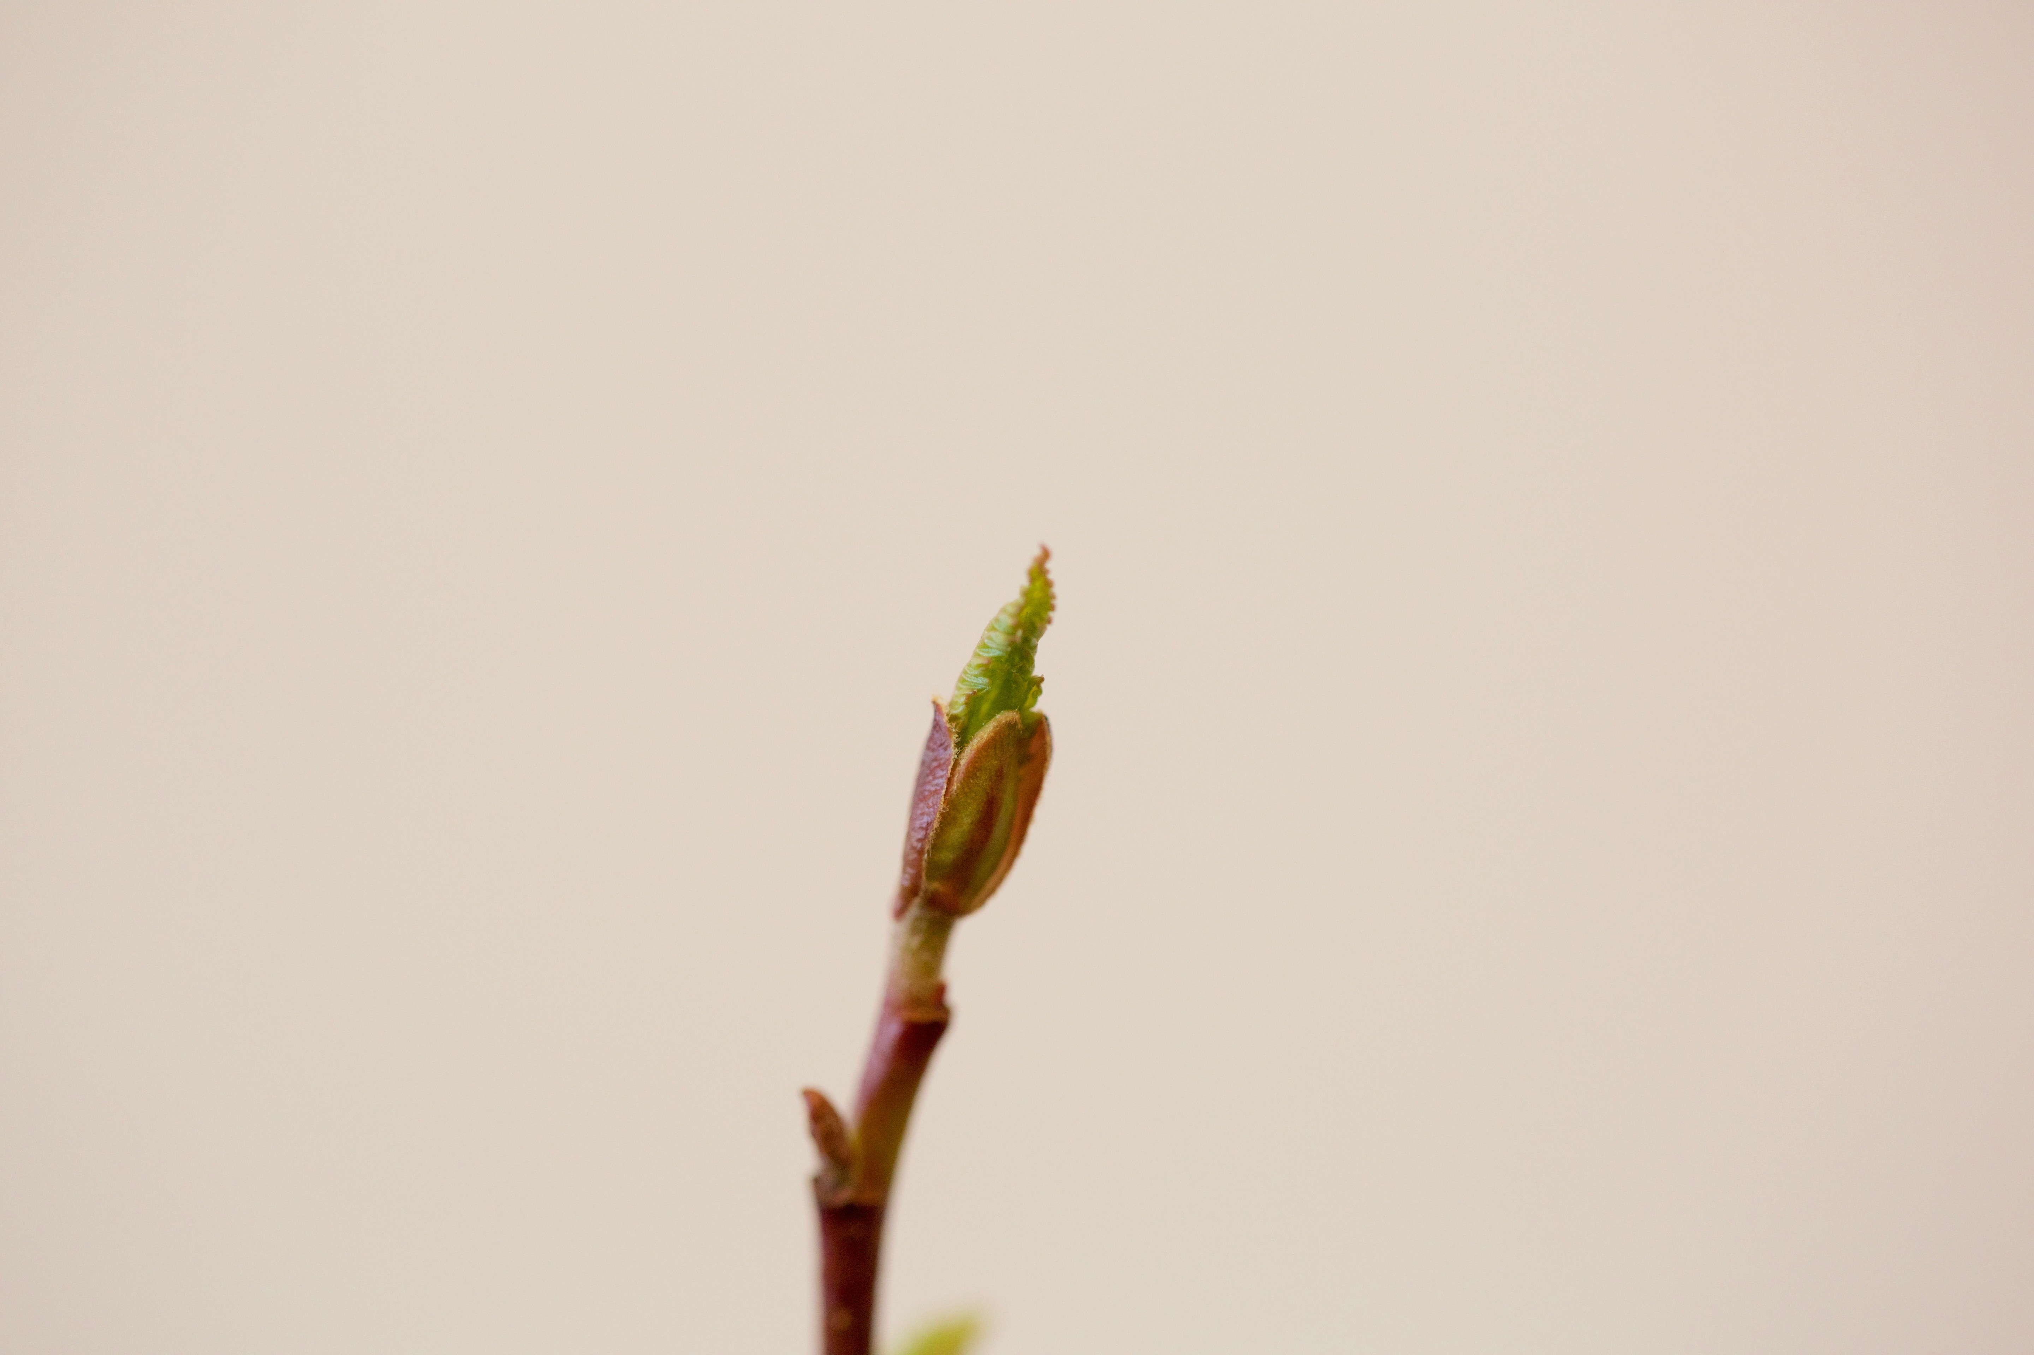
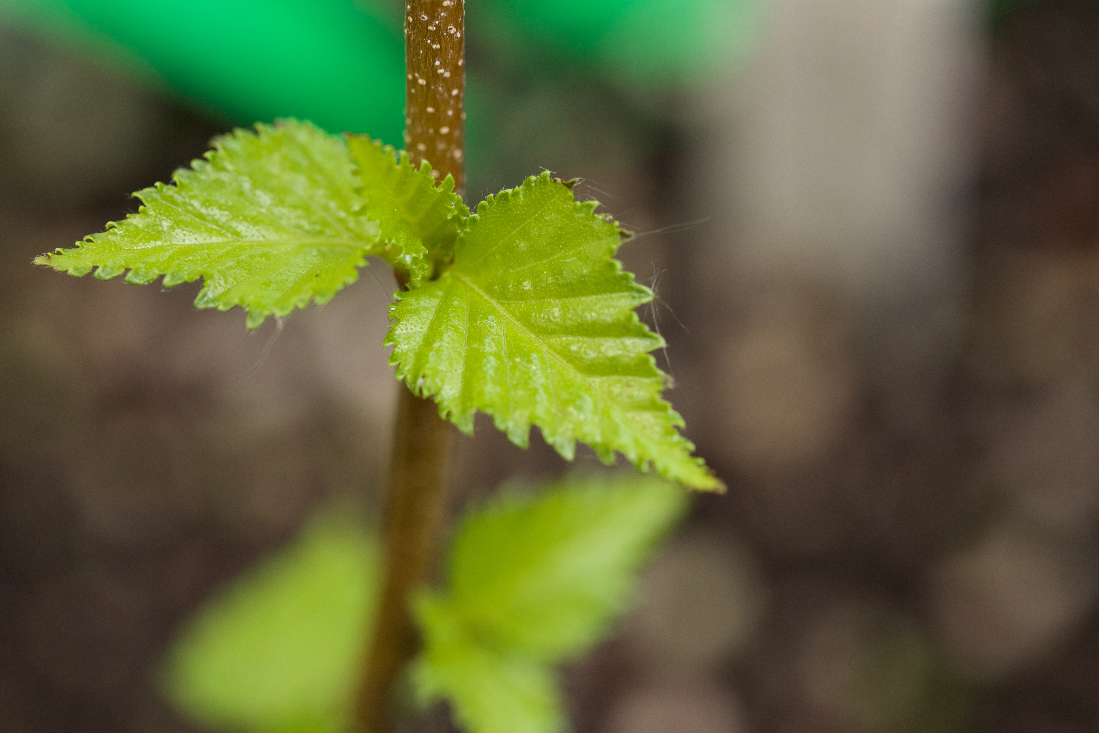
THE EFFECTS OF FALSE SPRING EVENTS ON FOLIATE PHENOPHASES AND THE DURATION OF VEGETATIVE RISK
Cat Chamberlain & Lizzie Wolkovich
HARVARD UNIVERSITY | ARNOLD ARBORETUM
ABSTRACT
Trees and shrubs growing in temperate environments are at risk of being exposed to late spring freezes, or false springs, which can be detrimental to growth. Individuals at certain phenophases (i.e. between budburst and full leafout) are more likely to incur damage from a freezing event than individuals past the leafout phenophase. The rate of budburst and the length of time between budburst and leafout is a crucial indicator for predicting level of damage from a false spring event. We will refer to the timing of these collective phenophases (i.e. budburst to leafout) as the duration of vegetative risk. In our study, we are assessing the effects of false spring events on the duration of vegetative risk. In a growth chamber experiment, we exposed 7 native deciduous tree species to a freezing event. In one treatment, drought conditions were applied prior to budburst and then individuals were put in a growth chamber for 24 hours at -3ºC, the second treatment maintained higher soil moisture levels prior to budburst and then was put in the same chamber and each group was compared to a control group. Our results indicate that freezing events occurring between budburst and leafout cause the duration of vegetative risk to increase. This increase could potentially expose leaf buds to more freezing events and subsequently increase the level of damage incurred..
Harvard University | Arnold Arboretum
Further studies are needed to investigate the amount of damage a freezing event causes and if a second freeze is as damaging
Budburst
Leafout
Duration of Vegetative Risk
OBJECTIVES
TREATMENT | MEAN RISK | STAND DEV
A | 17.157 | 6.559
B | 23.436 | 7.044
C | 25.318 | 7.549

